Slide 1
Understanding and Preventing the Eviction Process
Presentation and Q+A
Speaker:
Tracey Lasook
Community Legal Worker and Licensed Paralegal at Kinna-aweya Legal Clinic
May 12th, 12-12:45pm
Notes:
Hello everyone, welcome to Part 2 of our most recent Lunch and Learn Series. Today is part two in the housing series: Understanding and Preventing the Evictions process. Today, we are very happy to have Tracey Lasook sharing her expertise with us, Tracey is a Community Legal Worker and Licensed Paralegal at the Kinna-aweya Legal Clinic in Thunder Bay.
My name is Karen Dick and I am your CLEO host today. My colleague Urooj Ameeruddin is our CLEO tech specialist today – you can reach her in the chat if you have any issues.

Slide 2
What you can expect today
Lunch and Learn Series
45 minutes in total (presentation and Q+A)
This is legal information, not legal advice.
The information is current as of today’s date May 12, 2022
Recording and slides will be sent out afterward.
Subtitles (closed captioning) has been enabled.
Notes:
Our presentation today will run for 45 minutes in total – including time for you to ask questions using the Q+A function.
This is legal information only, not to be taken as legal advice. This includes answers to your questions that we will address during the presentation. These questions should be general and not related to a specific situation – Tracey won’t have the time to gather all the information necessary to answer these questions.
The information presented is current as of today's date May 12th, 2022.
Recording and slides will be sent out afterward.
Subtitles (closed captioning) has been enabled

Slide 3
Land Acknowledgement
CLEO’s work takes place across the home and traditional territory of the Mississaugas of the Credit, the Haudenosaunee, and the Wyandot peoples, on land that many of us know as Ontario. We encourage you to take the time to understand more about the land you live and work on.
As we provide legal information today, we acknowledge the ongoing impact of colonization and anti-Indigenous racism, built into our laws and legal systems, resulting in devastating pain and inequality for Indigenous Peoples of every generation.
We also recognize the incredible amount of work that Indigenous Peoples contributed to the Calls to Action in the Truth and Reconciliation Commission report calling for Equity for Indigenous Peoples in the Legal System.
Notes:
Of course we have to push our gov’t to work faster and harder to make those changes – take every chance you can get to do that. We have provided links for you to read about these calls to action as well as others – please take the time to read these and appreciate the meaning behind them. If you have any resources you’d like to share, please do so in the chat.
I will now hand over the floor to our presenter– Tracey Lasook, over to you. (STOP SHARING SLIDES)

Slide 4
AGENDA
1. Brief overview of what the Landlord and Tenant Board covers.
2. Some common landlord applications.
3. Some of the most common notices served on tenants.
4. N4’s and N5’s and Common Errors
5. Questions
6. N12’s and Common Errors
7. Some landlord applications
Questions

Slide 5

Brief Overview:
What does the Landlord and Tenant Board cover?

Slide 6
Jurisdiction of the Landlord and Tenant Board
Governs relationships between residential landlords and tenants and applies the Residential Tenancies Act
Certain kinds of tenancies are excluded, e.g. sharing a kitchen and bathroom with landlord, short-term accommodation provided as emergency shelter, living accommodation intended to be provided to the travelling or vacationing public
Residential Tenancies Act sets out application process for landlord and tenants, authority of Landlord and Tenant Board to order various remedies and assist in resolution of disputes between parties
*** The RTA is very complex, this is a very brief overview, please seek legal advice if you have specific questions about a particular situation

Slide 7
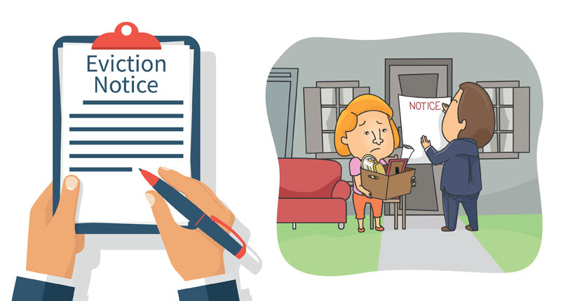
BUT FIRST, The Notice

Slide 8
Some of the most common notices served on tenants
Some of the most common notices served on tenants are:
  N4: Notice to End your Tenancy Early for Non-payment of rent;
  N5 Notice to End your Tenancy for Interfering with Other, Damage, or Overcrowding
  N6: Notice to End your Tenancy for Illegal Acts or Misrepresenting Income in a Rent-Geared-to-Income Rental Unit
  N7: Notice to End your Tenancy for Causing Serious Problems in the Rental Unit or Residential Complex
  N12: Notice to End your Tenancy Because the Landlord, a Purchaser or a Family Member Requires the Rental Unit
  There are numerous other notices as well but we will be focusing on the N4, N5 and N12 today.

Slide 9
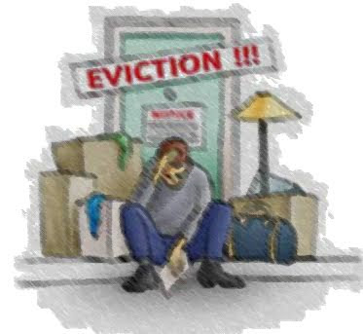
The Notice is Only the First Step
Many tenants receive a Notice of Termination and mistakenly believe that they must move out of the rental unit by the termination date that is set out in the notice.
If you do not take away anything else from today’s presentation, please remember this:
THE NOTICE IS ONLY THE FIRST STEP IN THE EVICTION PROCESS.
Tenants DO NOT have to leave the rental unit just because they have received a notice of termination, regardless of the reason.

Slide 10

Clear as MUD
These notices can be confusing to tenants and their advocates.
BUT, they can also be confusing to the person filling them out.
Sometimes an error in the notice can help the tenant. The Landlord and Tenant Board generally cannot order an eviction if there are serious mistakes in the notice.
We will now look at some of the most common errors that landlords make when filling out these forms and when serving them.

Slide 11

So you fell behind in your rent

Slide 12
N4: Notice to End Your Tenancy Early for Non-payment of Rent
https://tribunalsontario.ca/documents/ltb/Notices%20of%20Termination%20&%20Instructions/N4.pdf

Slide 13
Common Errors:
Check to make sure that all of the tenants who are living in the rental unit who are over the age of 18 are listed in the address section of the notice.
Check the address of the rental unit to make sure it is correct and complete.
Check the date the notice was signed (page 2), rent is not considered late until the day after the rent is due.
Count the number of days between the day after the notice was received and the termination date (page 1) NOTE: the date that the notice was signed is not necessarily the date it was received.

Slide 14
Common Errors continued:
Ask the tenant when they received the notice. How do they know? Do they have a point of reference as to when they received it?
Ask the tenant HOW the notice was served – was it under their door? in their mailbox? Was it sent by regular mail? Was it hand delivered? Was it sent by email? Did they agree to service by email in writing?
On page 2 check to make sure all payments made by the tenant have been listed. Ask them to obtain proof if possible of all payments. Types of proof: receipts issued by landlord, bank records of e-transfer, tenant pay or direct pay, cheque, money order, etc. We suggest that you never pay in cash unless you get a receipt at the time of the payment.
Make sure that the DATE section is completed correctly. If the tenant pays rent on the 1st of the month then the rental period should be the 1st of the month to the last day of the month, some landlords put the 1st of the month to the 1st of the next month and this is incorrect.

Slide 15
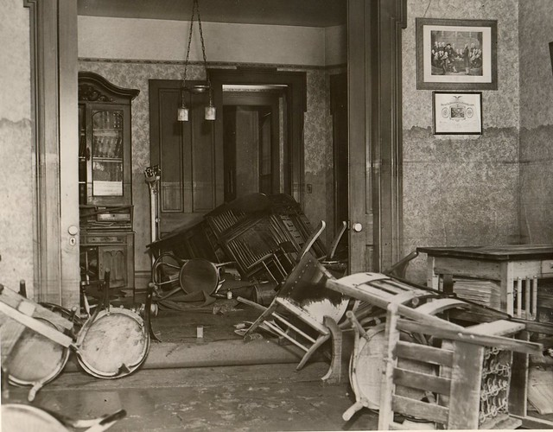
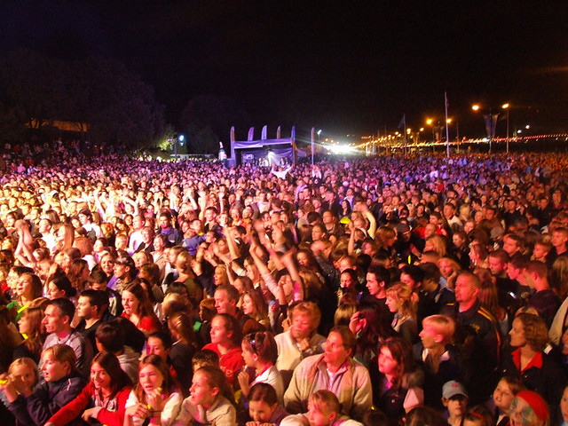
Behavior, Damage or Overcrowding

Slide 16
N5 Notice to End your Tenancy for Interfering with Other, Damage, or Overcrowding
https://tribunalsontario.ca/documents/ltb/Notices%20of%20Termination%20&%20Instructions/N5.pdf

Slide 17
Common Errors:
As with the N4, check to make sure that the address of the rental unit is correct and that all tenants over the age of 18 are listed
Check the date the notice was received by the tenant
Ask the tenant how they received the notice – under their door, in the mailbox? by regular mail? By Email? Did they agree to service by email in writing? How do they know when they received it? Do they have a point of reference?
Count the number of days from the day the tenant received the notice to the termination date on the first page. In the case of an N5 the tenant must be given 20 days notice even though the remedy period in the notice is 7 days.

Slide 18
Common errors continued:
On page 1 check to make sure that at least one of the reasons for issuing the notice is checked off.
Also on page 1 check to make sure that if the reason for the notice is the tenants behaviour or the behavior of their guests that either the box advising the tenant(s) that they have 7 days to correct the behaviour being complained about has been checked off OR, that the box indicating that this is their second notice within 6 months and that they do not have the opportunity to remedy their behaviour and that they landlord may apply to the Landlord and Tenant Board for an Order terminating the tenancy immediately
If the reason is damage then the landlord must advise of the necessary repairs, the cost to do the repairs or the cost to replace the item if it cannot reasonably be repaired. Again the tenant has 7 days to repair the damage or pay the amount claimed if they agree that they or their guests are responsible for the damage. Regular wear and tear is not damage. There is a Schedule in the Regulations made under the RTA that sets out the useful life of things https://www.ontario.ca/laws/regulation/060516#BK71
Is there a By-law regarding overcrowding? Sometimes landlords try to use this because you have a roommate. This is usually not considered overcrowding. Example: Thunder Bay’s by-law states “Every Owner of Residential Property must: (a) abide by the requirements of the Building Code Act, 1992 with respect to the maximum number of Occupants residing on a permanent basis in a Dwelling Unit;” The tenant must be given 7 days to reduce the number of people in the unit IF it is actually overcrowded.

Slide 19
Common Errors continued:
Another common error that some landlords make when completing an N5 is that they do not provide sufficient details about the behaviour being complained of or the alleged damage to the rental unit
The details section of the Notice must provide the tenant with enough information to know what the problem is AND how to rectify it if it is a first notice.
Example damage.
Example behaviour.

Slide 20

QUESTIONS

Slide 21

Owner or Purchaser’s Own Use

Slide 22
  N12: Notice to End your Tenancy Because the Landlord, a Purchaser or a Family Member Requires the Rental Unit
https://tribunalsontario.ca/documents/ltb/Notices%20of%20Termination%20&%20Instructions/N12.pdf

Slide 23
Common Errors:
Check to make sure that all tenants over the age of 18 living in the rental unit are named in the Notice of Termination
Check to make sure that the address is correctly listed
Ask the tenant when they received the notice of termination and how. Did they receive it in their mailbox? By regular mail? Was it hand delivered? Was it left under their door? Did they receive it by email? Did they agree to service by email in writing?
How do they know when they received it? Do they have a frame of reference?
What date was the Notice of Termination signed? This is imperative in cases of purchasers own use as the notice cannot be issued BEFORE the Agreement for Purchase and Sale has been signed. (although you may not be provided with a copy of the Agreement until the hearing)
Did the landlord pay the tenant one month rent in compensation BEFORE the termination date in the notice? This is a requirement!

Slide 24
Common Errors continued:
Is the termination date on Page 1 of the notice the last day of the rental period or the last day of lease?
Check to make sure that the person who claims to be moving into the unit or house is one of the eligible persons listed under the law. The landlord’s cousin, aunt, uncle, etc., are not eligible persons for the purposes of an N12
In the case of a notice for Own Use – check to make sure the person giving notice is the sole owner and not a multi-landlord corporation (these cases can be quite complicated and may require the assistance of a legal clinic)
In the case of a notice for Own Use – check the rental listings, etc. to see whether the unit is being advertised as being available FOR RENT in the near future (within 1 year of the termination date)

Slide 25
Common Errors continued:
If you have doubts about whether the notice is in good faith, in the case of Own Use or Purchaser’s Own Use, if possible try to find out where the person who claims to be moving into the unit lives. This information can be used to try to demonstrate that it would be unlikely that someone in the landlord or purchaser’s financial position would move from a higher financial neighbourhood to a basement apartment in a lower financial neighbourhood.
The same is true for any other family member they claim is moving in – where do they work or go to school, does it make sense for them to be moving into this neighbourhood, if its an elderly parent, is the house or apartment suitable for them i.e. lots of stairs, etc.

Slide 26


Slide 27

Landlord Application to the Landlord and Tenant Board

Slide 28
Some Common Landlord Applications
After the landlord has served a notice of termination, if the tenant does not choose to move out, then the landlord must make an application to the Landlord and Tenant Board to get an Order to terminate the tenancy
This is true whether the application is based on tenant’s behaviour, e.g. unpaid rent, persistent late payment of rent, engaging in an illegal act, serious impairment of safety, substantially interfering with reasonable enjoyment of other tenants or lawful rights of the landlord or due to a “no fault” application, e.g. landlord or purchaser’s own use, demolition or repairs that require vacant unit

Slide 29
Landlord applications con’t
In some cases the landlord must wait until the day after the termination date in the notice to file the application. In other cases they may file the application immediately after serving the notice. It will say in the notice when the landlord may file the application.
The Landlord and Tenant Board will schedule a hearing. The tenant has the right to attend the hearing to challenge the termination of the tenancy.
Only Landlord and Tenant Board has the authority to order the termination of a tenancy.
Only the Sheriff has the right to enforce an Order.

Slide 30
Resources and supports:
Steps to Justice
Housing Law – Evictions
Eviction Process at the LTB
Evictions Solution Explorer
Advocacy Centre for Tenants Ontario (ACTO)
My order from the LTB is wrong – what to do?
I got an eviction order because I owe rent – what to do?
I got an N4 notice – what can I do?
Tribunals Ontario Portal – Landlord and Tenant Board
N4: for non-payment of rent
N5: for interfering with other, damage or overcrowding
N12: when landlord or new owner requires the rental unit
Notes:
Here are more supports related to today’s presentation to help you in your work.

Slide 31
Resources and supports:
Part 1: Navigating Virtual LTB Hearings (April 28, 2022)
Slides and Recording
Find your Community Legal Clinic
https://www.legalaid.on.ca/legal-clinics/

Slide 32
Calls to action: Truth and Reconciliation
Truth and Reconciliation Commission of Canada: Calls to Action
Settlers Take Action
Education
Indigenous Canada - Free Course
Whose Land?
Learn about where you are situated, information for land acknowledgements and learn about the treaties and agreements signed across Canada (Turtle Island).
Whose Land?
Notes:
Here are the links I mentioned earlier – please make sure to visit these sites and consider and evaluate your own work, how can we step up and contribute to the many movements and campaigns for change happening right now across the country.

